Slide 1
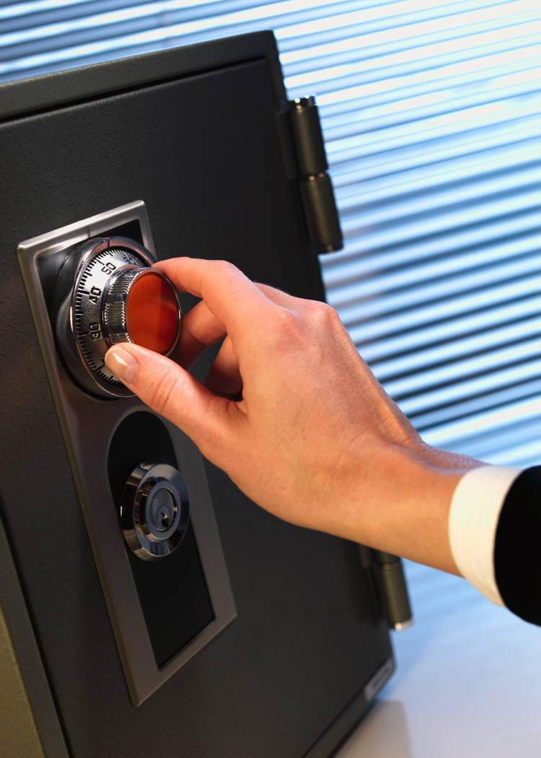
Test Coordinator Training
Spring 2015
Test Security

Slide 3
Standardization
Equity, access, and validity of results
Standardization maintained through ADMINISTRATION
TAs read DFAs and TAMs BEFORE testing

Slide 4
Standardization
Standardization
TAs adhere to ALL directions and instructions in DFA/TAMs
During testing, TAs read scripts from DFA/TAMs EXACTLY as written

Slide 5
Prohibited Practices
Photocopying or reproducing test materials
Paraphrasing test questions or directions
Coaching or assisting students with items before, during, or
after the assessment
Allowing students to interact until all students have tested

Slide 6
Prohibited Practices
Leaving test materials unattended in unlocked room
Taking test materials off campus (unless authorized by PED)

Slide 7
Prohibited Practices
Diminishing the significance or importance of the tests
Having a cell phone, smart phone, e-reader, or tablet on person during testing (staff may use devices for internal communication)
Stray-mark clean-up is STRICTLY PROHIBITED

Slide 8
Storage of Test Materials
LOCKED storage with limited access
Account for all materials DAILY with details check-in and check-out forms
Staff should not leave test materials in unattended classrooms
Securely shred scratch paper for PARCC.

Slide 9
Materials Chain of Custody
Count each PBT booklet every time
it changes location
Sign in/out all secure materials, including Student Testing Tickets and scratch paper.
Check sheets should indicate
movement of materials for extended
time, make-ups, accommodations, etc.

Slide 10
Missing Materials
Immediately report any missing materials
to STC, DTC, and Superintendent. If not located, a comprehensive Test Irregularity report must be filed with PED within 3 business days of the incident.
For PARCC, also complete and submit ‘Form to Report Contaminated, Damaged, or Missing Materials’ to Pearson.

Slide 11
Testing Irregularity
Any circumstance within or beyond the control of a school district that in the opinion of the PED or a school district, raises doubts about the propriety of standardized testing procedures, preparation of materials, standardized test administration, standardized testing security, student scores attained from standardized testing, or teacher or student conduct observed during standardized testing.
(6.10.7.7-A NMAC)

Slide 12
Testing Irregularity
If a testing irregularity occurs:
TA reports to STC
STC reports to DTC
DTC and STC conduct internal investigation
DTC fills out and submits PED Testing Irregularities Reporting Form (do not use PARCC ‘Form to Report a Testing Irregularity or Security Breach’)

Slide 13
Testing Irregularity
Report Testing Irregularities for:
PARCC
SBA
HSGA
NCSC/NMAPA/AAHSG
EoCs
ACCESS/W-APT
Interim Assessments (if part of EES)

Slide 14
Testing Irregularity
Results of Testing Irregularities:
Implementation of procedures to prevent similar irregularities in future
Possible invalidation of student scores if test is not a valid exhibit of student abilities
Possible reprimand of staff

Slide 15
Common Testing Irregularities
Students continue past current session (PBT only).
Students caught with electronic device
TAs Must Circulate Room And Ensure That Students Do Not Proceed Beyond Current Session.

Slide 16
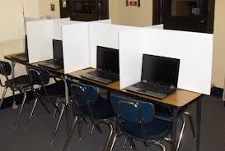
CBT-Specific Test Security
Students must be unable to see another student’s screen.
Student Testing Tickets and scratch paper are secure materials.
Students need enough room at workstation to write on scratch paper.
Adjust computer volume for headphone use (videos and
text-to-speech) prior to testing.
.

Slide 17
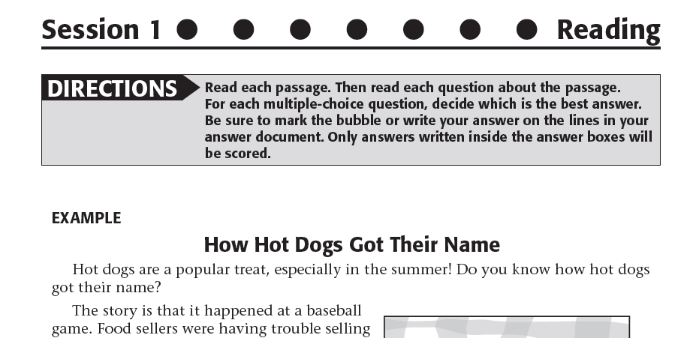
SBA Session Symbols
At top of SBA test booklet
pages
Session 1: Circles
Session 2: Triangles
Session 3: Squares

Slide 18
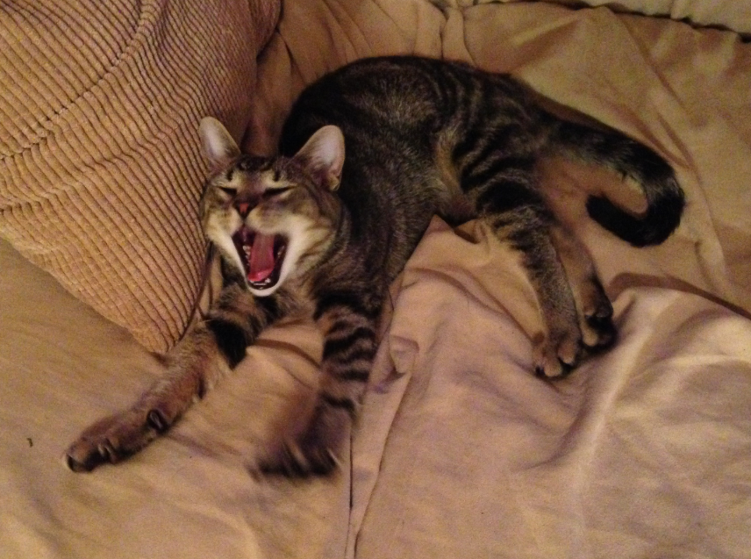
Questions?

