Slide 1
Teacher Value-Added and Chetty and Kane’s Testimonies in the Vergara Trial Biased Science, Camouflaged Results Moshe Adler Columbia University and the Harry Van Arsdale Jr. Center for Labor Studies

Slide 2
This presentation is based on a debate with Chetty et al.
http://nepc.colorado.edu/newsletter/2014/06/adler-response-to-chetty
Papers Reviewed:
Chetty et al., Final AER Papers, http://obs.rc.fas.harvard.edu/chetty/value_added.html
Kane, Vergara court presentation
http://studentsmatter.org/wp-content/uploads/2014/02/SM_Kane-Demonstratives_02.06.14.pdf

Slide 3
What Is Teacher Value-Added?
Value-added modeling seeks to isolate the contribution, or value-added, that each teacher provides [to her students] in a given year, which can be compared to the performance measures of other teachers (Wikipedia).

Slide 4
Why Is Teacher Value-Added Important?
Cited by President Obama in a State of the Union Address as a way to pull children out of poverty
Heralded in front page 2012 New York Times article with the headline "Big Study Links Good Teachers to Lasting Gain"
Widely thought to be a legitimate method to evaluate the effectiveness of teachers (though detractors, including the educator Diane Ravitch, have called it "junk science")
Currently cited in key court cases to justify abolishing tenure
It diverts the conversation from low taxes and low wages to “bad teachers” and an “under-educated” labor force

Slide 5
Part I: Key Question
Does teacher quality, as measured by Teacher VA, matter?
Chetty et al. are the first (and so far the only) researchers who addressed this question, and their answer is YES. A one SD (Standard Deviation) increase in a teacher’s VA score increases the income of her students by $286 a year at age 28, and it continues to increase their income by 1.34% throughout their lives, Chetty et al. claim.
But this claim is based on bad methodology.

Slide 6
Chetty et al.:
Ignored results that contradict their main claim
Selected data in a way that biases their results
Used units that inflate their results by a factor of 10

Slide 7
Chetty et al. Ignore Three Results That Contradict Their Claim
In the first version of their papers Chetty et al. had 61,639 observations for 30 year-olds, and they found that an increase in teacher value-added has no statistically significant effect on income at age 30. This result has not been reported in the second version.
In the second version they had 220,000 observations for 30 year-olds, and their result for these observations is not given. Instead the authors dismiss the result by stating that they “dropped the estimates at age 30 in the interest of space since there is inadequate data at age 30 to obtain precise estimates.” This means that even with 220,000 observations the result was not statistically significant.

Slide 8
Ignored Results (cont.)
In the first version Chetty et al. had 376,000 observations for 28 year-olds and they deemed this number sufficient for their calculations. But the 28 year-olds of the first version are the 29 year-olds of the second version. (The subjects in the second version are the same individuals as in the first, but because they are a year older, there is an additional year of data about their incomes.) In the first version that number was deemed sufficiently large. How is it that the same number become insufficient in the second version? If the result for 29 year-olds was statistically insignificant, and these are the same subjects they had in their previous sample, this is a very important result of this study, and to not discuss it in order “save space” is scientifically unacceptable.
In the latest version Chetty et al. had 61,639 observations for 31 year olds (who were 30 year-olds in the first version). The results for this age group should have been reported as well.

Slide 9
How Many Observations Are Sufficient?
Chetty et al. had a sample of 61,639 observations for 30 year-olds in their first version, and the result of their research was that the hypothesis that Teacher Value-Added does not affect income, could not be rejected. They then proceeded to ignore this result, arguing that the sample was too small. My own calculation yielded that the sample was sufficient, but Chetty et al. responded that my calculation was wrong. Perhaps. But nowhere do they provide their own calculation.

Slide 10
Number of Observations (cont.)
376,000 observations for 29 year-olds, 220,000 for 30 year-olds and 61,639 observations for 31 year-olds are all very large numbers and cannot arbitrarily be stamped “insufficient.”
Not reporting results of statistical tests with these many observations in order to “save space” amounts to concealing results that contradict the authors’ main claim in their research.

Slide 11
If Ages 29-31 Had Been Included in Figure 2b

Slide 12
1.34% of What?
Chetty et al. calculated that an increase of 1 standard deviation in Teacher Value-Added increases income by $286 a year at age 28. This constitutes 1.34% of average income of all 28 years old, but only because their calculation of average income includes the workers to whom they assigned zero income. The average income for 28 year-olds in 2010 dollars, was $21,256.
An increase of 1.34% in the income of a person who earns an income is meaningful. But to somebody who does not earn anything this number is meaningless. 1.34% of what?
1.34% could not be the average increase in income for all 28 year-olds, because even a penny is an infinite percentage increase for a worker who had zero income.
Observations with zero income should not have been included in the calculation of the percentage increase of income because doing so both inflates it and at the same time renders it meaningless.

Slide 13
The 1.34% increase at Age 28 DOES NOT Hold Over a Lifetime Even in Chetty et al.’s Own Data Set
Chetty et al. assume that this increase in income will hold throughout a person’s life, and use it to get a $39,000 increase in a student’s lifetime income due to having a teacher with a 1 Standard Deviation higher Value Added for just one year in grades 4-8.
Chetty et al.’s assumption that the 1.34% increase in income at age 28 would continue over a lifetime is contradicted by the authors’ own results. No increases in income were statistically significant at ages 29, 30, and 31.

Slide 14
Selecting Data That Yields the Desired Result
Chetty et al. found that a 1 standard deviation increase in Teacher Value-Added increases income by $286/year at age 28. ($182/year in an earlier version.)
In order to arrive at this result Chetty et al:
Included in their data 28 year olds who did not file form 1040 and did not receive a W-2 form. To these workers Chetty et al. assigned the income of zero. These workers constituted 29.6% of the observations.
Assigned an income of $100,000/year to 1.3% of the workers who earned more than this sum. (In fact, among workers with reported income, 1.9% were high-earners. The figure 1.3% is based on the inclusion of non-filers.)

Slide 15
The Inclusion of Non-Filers Biases the Calculations
Workers who do not report income may nevertheless be employed and earn wages. According to the New York Times, “Various estimates put the tax cheat rate at 80 to 95 percent of people who employ baby sitters, housekeepers and home health aides.” The same is probably true for other professions, including handymen and tutors. Assigning zero income to workers who have income biases the results. Non-filers should not be included in the data.

Slide 16
Non-Filers (cont.)
Suppose non-filers were indeed unemployed and had zero income. Even then they should not have been included in the data. The reason is that the effect of Teacher VA on the income of workers who are unemployed would be vastly different from its effect on the Income of workers who are employed. While it is possible that an increase in Teacher Value-Added would increase the income of an employed worker by $286/year, for a person who switches from being unemployed to being employed the increase in income would be much larger. (The newly employed would on average get a job that pays the average wage of $21,256.) Therefore, non-filers should not have been included in the same data set as filers.
As we shall see, the inclusion of non-filers biases not only the measurement of the change in income, but even more dramatically, the measurement of the percentage change in income, that is due to a change in Teacher VA.

Slide 17
“Capping” High Earners
When just a few observations are very different from the rest, they are called “outliers,” and they may be removed from the data. But this is NOT what Chetty et al. did. What they did is “cap earnings in each year at $100,000 to reduce the influence of outliers” (page 9, second paper). Outliers may be removed, but instead Chetty et al. assigned to high earners values that are different from the ones they had. Thus instead of data Chetty et al. used manufactured data.

Slide 18
An Example of How Such Data Manipulations Can Lead to: Higher Teacher VA = Higher Income Even if the opposite is the case

Slide 19
When Only Employed Workers Are Included, Higher Teacher VA (TVA) Decreases Income
All Employed Workers
TVA | INCOME
0 | Non-Filer
0 | 80
0 | 200
1 | 40
1 | 100

Slide 20
Add Non-Filers Result is ‘Better,’ but TVA Still Decreases Income
Assign zero to non-filers
TVA | INCOME
0 | 0 (non-filer)
0 | 80
0 | 200
1 | 40
1 | 100

Slide 21
Keep Non-Filers, Remove Outliers: Result ‘Even Better,’ But Still ‘Not Good,’ Income Unaffected by TVA
With Non-Filers without Outliers
TVA | Income
0 | (Unknown) 0
0 | 80
1 | 40
Remove Outliers
TVA | INCOME
0 | 0 (non-filer)
0 | 80
0 | 200
1 | 40
1 | 100

Slide 22
Keep Outliers, But Cap Them: Voilà
Cap high-earners
TVA | INCOME
0 | 0 (non-filer)
0 | 80
0 | 100 (200)
1 | 40
1 | 100

Slide 23
What Does a 1 SD Increase in Teacher Value-Added Mean?
Chetty et al. found that a 1 Standard Deviation increase in Teacher VA leads to improvements in student scores of of .14 SD in Math and .1 SD in English. What do these numbers mean?

Slide 24
California CST, 2006, Range of Scale Score 150-600

Slide 25
California CST, 2006, Range of Scale Score 150-600

Slide 26
Let’s Call a Percentage a Percentage
Hence, on a scale of 0-100 (using the figures for all elementary school grades in the CST scores table)
1 SD = 9 points in math; 7 points in English
Average Score = 43 point in Math; 41 points in English
To the average student an improvement of Teacher VA by one SD yields an increase in score of .14 SD, or 3% of her grade in Math, and .1 SD, or 2% of her grade in English.
If the score of the average student on a test is 60, in points the increases would be of 2 points in Math and 1 points in English in the year in which the higher VA teacher is in the classroom.

Slide 27
Fade-Out
The effect of teacher value-added on test scores fades-out rapidly. In year 4 it is .25 of what it was in year 1. (Chetty et al. did not check whether this decline continues in later years.) This means that an increase of Teacher VA by one SD leads to an increase in test scores of .025 SD in student scores after 4 years or .75% for Math and .5% for English for Math. In points the average student would have scored the same 60% in Math and in English regardless of whether she had high VA teachers in both classes four years earlier.
If teacher value-added does not have a meaningful lasting effect on test scores even while the child is in school, why would it have a lasting effect on a person’s income throughout his or her life?
Chetty et al. deal with this question in two ways.

Slide 28
Fade-Out 1: Inflating the results ten times

Slide 29
Inflating the Results
In Figure 4, and only in Figure 4, Chetty et al. do not measure increases in Teacher VA in Standard Deviations; they use a different unit that is equivalent to an increase of about 10 Standard Deviations of Teacher VA.
An increase of this magnitude in Teacher Value-Added is not possible because such teachers do not exist. In fact, the range of teacher value-added in the Chetty et al. data is from about -1.5 to +1.5 teacher SD (Figure 2, paper 2), or a maximum difference of 3 SD’s. I contacted one of the co-authors about this when it appeared in the first version; here is what he said:

Slide 30
Letter from Chetty et al. Co-Author Jonah Rockoff
“This is definitely a language error on our part. Instead of ‘a one SD increase in teacher quality’ we should have said ‘an increase in teacher value-added of one (student-level) standard deviation.’ Of course an increase of one in value added is roughly 10 teacher-level standard deviations, so your assessment of 0.03 in year three for a one teacher-level SD increase in year 0 would be correct.” (Jonah Rockoff to Moshe Adler, personal communication, October 12, 2012).

Slide 31
Question of Substance, Not Terminology
Even though the authors were alerted to the problem, they did not correct it. On the contrary, in the second version they write:
“In our companion paper, we estimate that 1 unit improvement in teacher VA in a given grade raises achievement by approximately 0.53 units after 1 year, 0.36 after 2 years, and stabilizes at approximately 0.25 after 3 years (Chetty, Friedman, and Rockoff 2014, Appendix Table 10). Under the assumption that teacher effects are additive across years, these estimates of fade-out imply that a 1 unit improvement in teacher quality in all grades K-8 would raise 8th grade test scores by 3.4 units.”
This statement inflates the results ten times. (The additivity assumption is also a problem, but will not be discussed today. See my NEPC review)

Slide 32
Fade-Out 2: A Misleading Reassurance
The second way Chetty et al. deal with the problem of the Fade-Out is by citing two studies that they claim buttress the validity of their own results. This claim is both wrong and misleading. The two studies are by David Deming and by Heckman et al. Deming investigated Head Start while Heckman et al. investigate the Perry Program, an intense pre-school family intervention program. Both found lasting effects of the programs without increases in test scores. Heckman et al. specifically draw attention to the distinction between the concerns of education economists and the concerns of these particular early education programs. They explain:

Slide 33
Fade-Out (cont.)
“The literature in the economics of education assumes the primacy of cognitive ability in producing successful lifetime outcomes. . . From this perspective, the success of the Perry program is puzzling. Although the program initially boosted the IQs of participants, this effect soon faded. . . Consistent with this evidence, we show negligible effects of increases in IQ in producing program treatment effects. Although Perry did not produce long run gains in IQ, it did create persistent improvements in personality skills. The Perry program substantially improved Externalizing Behaviors (aggressive, antisocial, and rule-breaking behaviors), which, in turn, improved a number of labor market outcomes, health behaviors, and criminal activities.”
While it is easy to understand why the Perry Project and Head Start lead to success in adulthood despite the fade-out in test scores, it does not follow that short-duration improvements in elementary school test scores would lead to economic success in adulthood. Citing early childhood programs as evidence that the fade-out of test scores in programs that are designed to increase test scores does not matter, is troubling.

Slide 34
Part II: Common Problems in Chetty et al. and Kane’s Vergara Opinion
Kane’s Opinion is at:
http://studentsmatter.org/wp-content/uploads/2014/02/SM_Kane-Demonstratives_02.06.14.pdf

Slide 35
Unit
Kane and many other Teacher-VA-economists present the effects of increasing Teacher VA by “months of learning.” But this terminology is meaningless and misleading.
The terminology is meaningless because while it is possible to give students stipends that will increase their families’ incomes, improve their nutrition, teach them in smaller classes and deal with their psychological needs when they live under economic stress, and while it may be possible to give children better teachers without increasing teacher salaries, it is absolutely impossible to give students “months of learning,” because this will mean also taking an equal time from something else, away. Lay people may think they know what “months of learning” means, but in fact it is meaningless.
The terminology is also misleading, as we discuss below.

Slide 36
Kane’s Vergara Opinion Based on MET Findings for State Tests
Kane reports that giving a student a teacher who is at the top 25% of teacher VA instead of an average teacher is equivalent to giving the student 4.5 months of extra learning in math and 1.2 months of English compared to the average teacher. How did Kane calculate these figures?
According to Kane, an increase in student scores of .25 standard deviations is equivalent to an extra 9 months (a school year) of learning.
(www.metproject.org/downloads/MET_Gathering_Feedback_Practioner_Brief.pdf)
This means, then, that a top teacher increases a student’s score by 0.125 SD in Math and 0.333 SD in English or, in percentages of the average student’s score, 3% in Math and .6% in English. If the average score is 60 in both subjects, these increases would amount to 2 points and 0 points respectively, during the year that the teacher is in the classroom. But a loss of 4.5 months, and 1.2 months of learning is far more ominous than a loss of 2 or 0 points when the grade is 62 or… 60 points. (Of course, after 4 years the remaining improvement would be 1 point in Math and less than half a point in English.)

Slide 37
These Results Are Not Stable Across Tests and Therefore Teacher Value-Added Does Not Measure Teacher Quality
Kane reports very different effects of Teacher VA when different types of tests are administered (less than half of the previous effect for Math, almost double the effect for English). In his court opinion Kane does not discuss this instability, but this instability is problematic.

Slide 38
Instability (cont.)
In the MET study that Kane used for his opinion, the correlations between the “stable” teacher value-added measurements that used one test or the other were low, .37 for English and .54 for math. The economist Jesse Rothstein examined how teachers would fare if evaluated by these “stable” measurements. He calculated that with a correlation of .37, a third of the teachers who have a measurement at the top 20% of teachers according to one test are measured as being below average according to the other. With a correlation of .54 the odds of consistency are only slight better: 30% of the teachers who are measured to be at the top 20% of teachers according to one test are measured as being below average according to the other.
The state of Florida uses two different standardized tests, and McCaffrey and his co-authors found that of the teachers who were in the bottom 20% of the value-added score according to one test, 5% were at the top 20% and 16% were at the top 40% according to another test.
The high volatility of teacher value-added scores raises the suspicion that the measurement of teacher value-added does not actually measure teacher quality.

Slide 39
TVA’s Are Not Stable for the Same Teacher Across Years; Therefore They Don’t Measure Teacher Quality
As Chetty et al. acknowledge, the value-added scores of teachers “fluctuate” from year to year. As we have seen, McCaffrey et al. used data from Florida, and Koedel and Betts used data from San Diego, to examine the stability of value-added scores. Their results varied from place to place, but the average result was that 13% of teachers who were at the bottom 20% of the value-added scale in one year were at the top 20% the following year, and 29% of those at the bottom 20% were at the top 40% the following year. Similar results held at the top. Twenty-six percent of teachers who were in the top quintile in one year were in the bottom 40% the following year. Only 28% percent of teachers who were at the top one year stayed at the top the following year.

Slide 40
Good Fit? Bad Fit? (Chetty et al., paper 1)

Slide 41
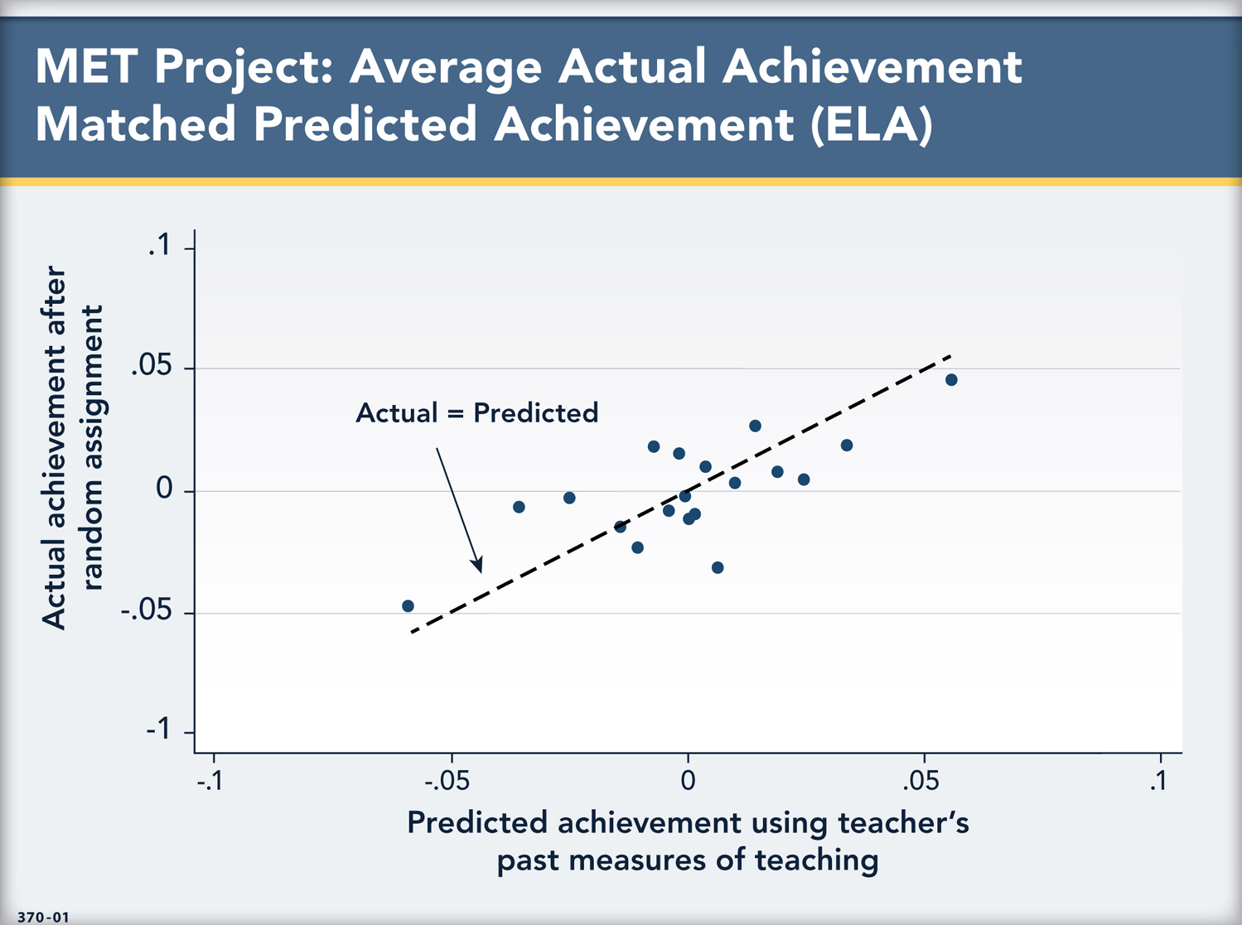
Kane’s Vergara Testimony

Slide 42
“Goodness of Fit”
Notwithstanding the near perfect fit that figure 2a and Kane’s figure present, it is possible that teachers with low predicted value-added scores had high actual scores and that teachers with high predicted scores had low actual scores.
“Goodness of Fit” is summarized by a number called R square, and its graphical representation is through a scatterplot of actual and predicted values. The authors claim to “augment” their regression analysis, but in fact they omit this determination and instead they include a plot that is misleading because it shows what to a lay person may appear to be a good fit, when in reality it may not be.

Slide 43
From Kane’s Vergara Testimony Exercise: Convert to Points (Answer in the next slide)

Slide 44
Answer
Scale of 1-100
9 months | .250 SD
1.08 month (Black Student) | .030 SD
1.55 month (Hispanic Student) | .043 SD
MATH
1 SD | 9 points
Average Grade | 43 points
Minority student loss due to teacher | .27 points (B)/.39 points (H)
Loss as percent of average grade | .6%(B)/.9%
ENGLISH
1 SD | 7 points
Average Grade | 41 points
Minority student loss due to teacher | .21 points (B)/.30 points (H)
Loss as percent of average grade | .5%(B)/.7%

Slide 45
Minority Loss in Points

Slide 46
Conclusion
As Heckman et al. explain, what children need is emotional, intellectual and material support from teachers, schools and family-oriented programs.
There is nothing that children need that the measurement of Teacher Value-Added can advance.

