Slide 1
Measuring College Value-Added: A Delicate Instrument
Richard J. Shavelson
SK Partners &
Stanford University
AERA
Ben Domingue
University of Colorado
Boulder
2014

Slide 2
Motivation To Measure Value Added
Increasing costs, stop-outs/dropouts, student and institutional diversity, and internationalization of higher education lead to questions of quality
  Nationally (U.S.)—best reflected in Spellings Commission report and the Voluntary System of Accountability’s response to increase transparency and measure value added to learning
  Internationally (OECD)—Assessment of Higher Education Learning Outcomes (AHELO) and its desire to, at some point if continued, measure value added internationally

Slide 3
Reluctance To Measure Value Added
“We don’t really know how to measure outcomes”—Stanford President Emeritus, Gerhard Casper (2014)
Multiple conceptual and statistical issues involved in measuring value added in higher education
Problems of measuring learning outcomes and value added exacerbated in international comparisons (language, institutional variation, outcomes sought, etc.)

Slide 4
Increasing Global Focus On Higher Education
4
How does education quality vary across colleges and their academic programs?
How do learning outcomes vary across student sub-populations?
Is education quality related to cost? student attrition?
AHELO-VAM Working Group (2013)

Slide 5
Purpose Of Talk
5
Identify conceptual issues associated with measuring value added in higher education
Identify statistical modeling decisions involved in measuring value added
Provide empirical evidence of these issues using data from Colombia’s:
  Mandatory college leaving exams and
  AHELO generic skills assessment

Slide 6
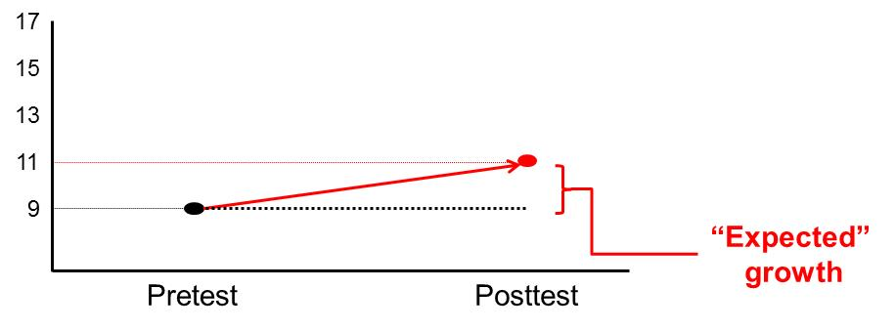
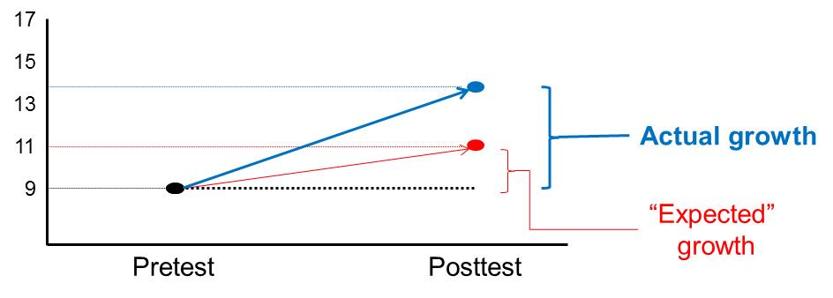
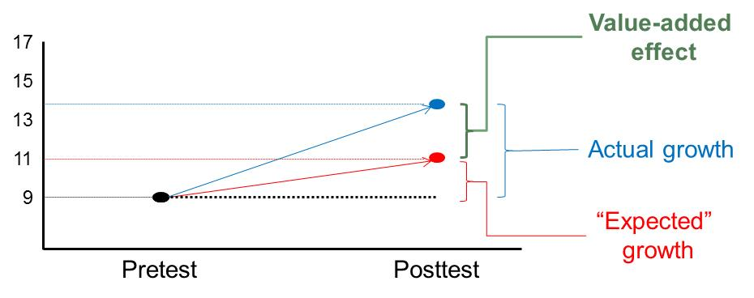
Value Added Defined
Value added refers to a statistical estimate (“measure”) of the addition that colleges “add” to students’ learning once prior existing differences among students in different institutions have been accounted for

Slide 7
Some Key Assumptions Underlying Value-Added Measurement
Manipulability: Students could theoretically be exposed to any treatment (i.e., go to any college).
No interference between units: A student’s outcome depends only upon his or her assignment to a given treatment (e.g., no peer effects).
The metric assumption: Test score outcomes are on an interval scale.
Homogeneity: The causal effect does not vary as a function of a student characteristic.
Strongly ignorable treatment: Assignment to treatment is essentially random after conditioning on control variables.
Functional form: The functional form (typically linear) used to control for student characteristics is the correct one.
Value-added measures attempt to provide causal estimates of the effect of colleges on student learning; they fall short
Assumptions for drawing causal inferences from observational data are well known (e.g., Holland, 1986; Reardon & Raudenbush, 2009)

Slide 8
Some Key Decisions Underlying Value-Added Measurement
What is the treatment & compared to what?
  If college A is the treatment what is the control or comparison?
  What is the duration of treatment (e.g., 3, 4, 5, 6, + years?)
  What treatment are we interested in?
    Teaching-learning without adjusting for context effects?
    Teaching-learning with peer context?
What is the unit of comparison?
  Institution or college or major (assume same treatment for all)?
  Practical tradeoff between treatment-definition precision and adequate sample size for estimation
  Students change majors/colleges—what treatment are effects being attributed to?

Slide 9
Some Key Decisions Underlying Value Added Measurement (Cont’d.)
9
What should be measured as outcomes?
  Generic skills (e.g., critical thinking, problem solving) generally or in a major? Subject-specific knowledge and problem solving?
  How should it be measured?
    Selected response (multiple choice)
    Constructed response (argumentative essay with justification)
    Etc.
  How valid are measures when translated for cross-national assessment?
What covariates should be used to make adjustment to account for selection bias?
  Single covariate—parallel pretest scores with outcome scores
  Multiple covariates: Cognitive, affective, biographical (e.g., SES)
  Institutional Context Effects: average pretest score, average SES
How to deal with student (ability and other) “sorting”? Choice of college to attend “not random!”

Slide 10
Does All This Worrying Matter: Colombia Data!
10
Yes!
Data (>64,000 students, 168 IHEs and 19 Reference Groups such as engineering, law and education) from Colombia’s unique college assessment system
  All high school seniors take college entrance exam: SABER 11—language, math, chemistry, and social sciences)
  All college graduates take exit exam: SABER PRO—quantitative reasoning (QR), critical reading (CR), writing, and English plus subject-specific exams
Focus on generic skills of QR and CR

Slide 11
Value-added Models Estimated
2-level hierarchical mixed effects model
  1. Student within reference group
  2. Reference group
Covariates:
  Individual level
    SABER 11 vector of 4 scores due to reliability issues
    SES (INES)
  Reference Group level
    Mean SABER 11 or
    Mean INSE
Model 1: No context effect—i.e., no mean SABER 11 or INSE
Model 2: Context with mean INSE
Model 3: Context with mean SABER 11

Slide 12
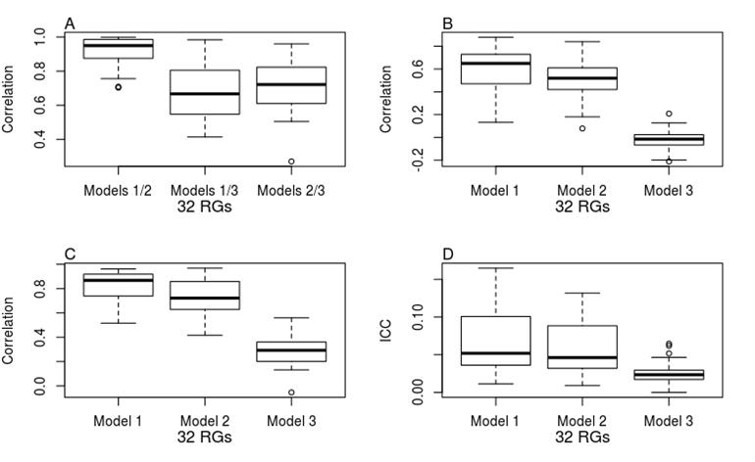
Results Bearing On Assumptions & Decisions
Sorting or manipulability assumption (ICCs for models that include only a random intercept at the grouping shown)
Context effects (Fig. A—32 RGs with adequate Ns)
Strong Ignorable Treatment Assignment assumption (Figs. B—SABER 11 and C—SABER PRO)
Effects vary by model (ICCs in Fig. D)

Slide 13
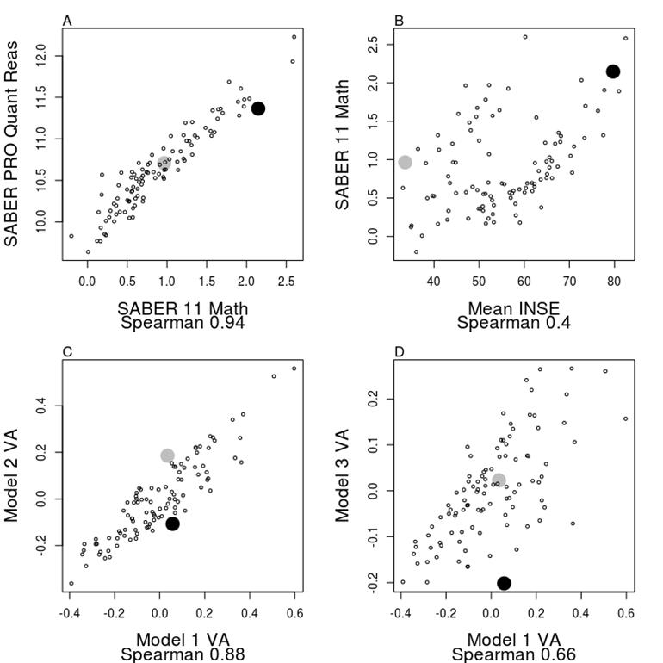
VA Measures—Delicate Instruments!
Impact on Engineering Schools
  Black dot: “High Quality Intake” School
  Gray dot: “Average Quality Intake” School

Slide 14
Generalizations Of Findings
SABER PRO Subject Exams in Law and Education
  VA estimates not sensitive to variation in Generic v. subject-specific outcome measured
  Greater college differences (ICCs) with subject-specific outcomes than with generic outcomes
AHELO Generic Skills Assessment
  VA estimates with AHELO equivalent to those found with SABER PRO tests
  Smaller college differences (ICCs) on AHELO generic skills outcomes than on SABER PRO outcomes

Slide 15
Thank You!

